Slide 1






Find Unique Usages Helping Developers Understand Common Usages
Emad Aghayi Aaron Massey Thomas LaToza
Department of Computer Science

Slide 2





How should I call “initialCapacity” method?
Bob
Documentation
Search / Read usages of this method
Notes:
Bob is a developer. He works on a task. On that task he needs to call method “inintialCapacity”.
The first solution comes to his mind is reading documentation. But documentation is not up to date. Codebase changed alot but document is not updated!!!!
He finds another solution. He thinks he can go through the codebases and read call sites that used “initCapacity”

Slide 3
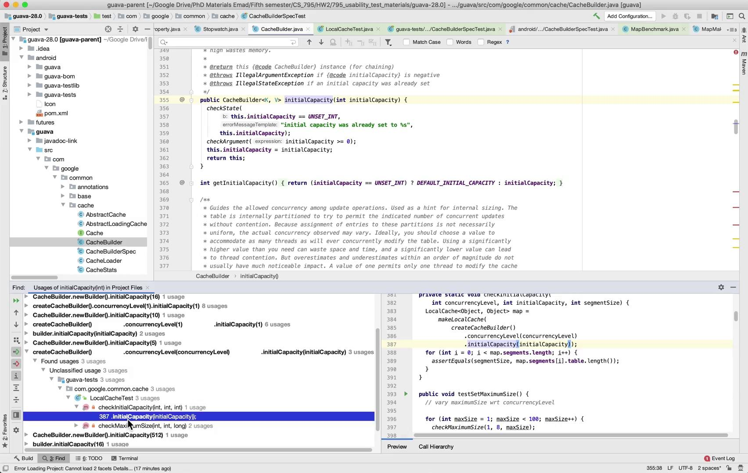
Let’s see how to use “initialCapacity” by using Find Usages in IntelliJ
Notes:
INCREASE QUALITY by CLICKING on GEAR Button
Bob use Find Usages tool of Intellij IDEA to find usages of “initCapacity” method
On the usages window he is looking at usages.
He tries to understand what are the possible range of inputs for “initCapacity”
Many of usage are duplicated
He should go through all of the usages to understand the “initCapacity” even those usages be duplicate and do not have anything for understanding the codebase

Slide 4
What is challenging about understanding method usages from call sites?
Notes:
What are challenges in finding usages in the codebase?
To answer these question we conducted an exploratory study.

Slide 5







Study 1: Challenges with Find Usages
Implement a feature in unfamiliar codebase
50 minutes
Survey
Notes:
Key result:
We found Find Usages tool is used by developers to understand codebase
We found that developers sometimes became overwhelmed by the number of usage results listed.
Developers focus on first or second usages in returned list.
This would lead to participants learning less from code examples.
Usages can be everywhere in project, tests, code

Slide 6
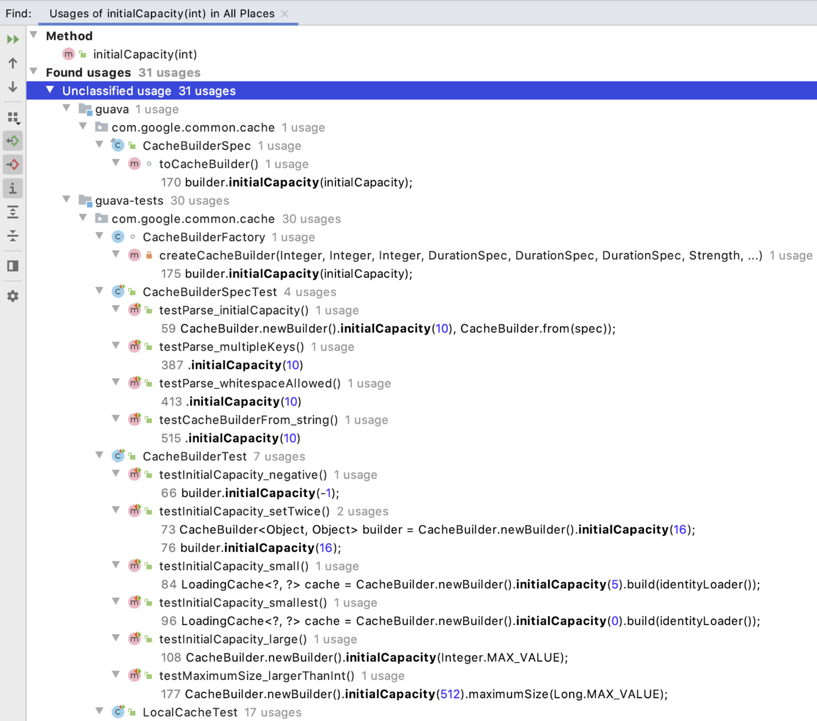
Study 1: Challenges with Find Usages
Key observations
Developers invoke find usages and learn from usages discovered
Developers have challenges when they discover many highly similar usages.
Developers select one or two usages and investigate these. This would lead to participants learning less from code examples.
Developers find usages in tests and call sites in their codebase
Notes:
Key result:
We found Find Usages tool is used by developers to understand codebase
We found that developers sometimes became overwhelmed by the number of usage results listed.
Developers focus on first or second usages in returned list.
This would lead to participants learning less from code examples.
Usages can be everywhere in project, tests, code

Slide 7
Hypothesis
Clustering similar usages might help developers understand usages more quickly and easily.
Notes:
After this study, based on these findings, we hypothesized that, rather than listing all usages separately, Clustering similar usages might might help developers understand usages more quickly and easily.

Slide 8
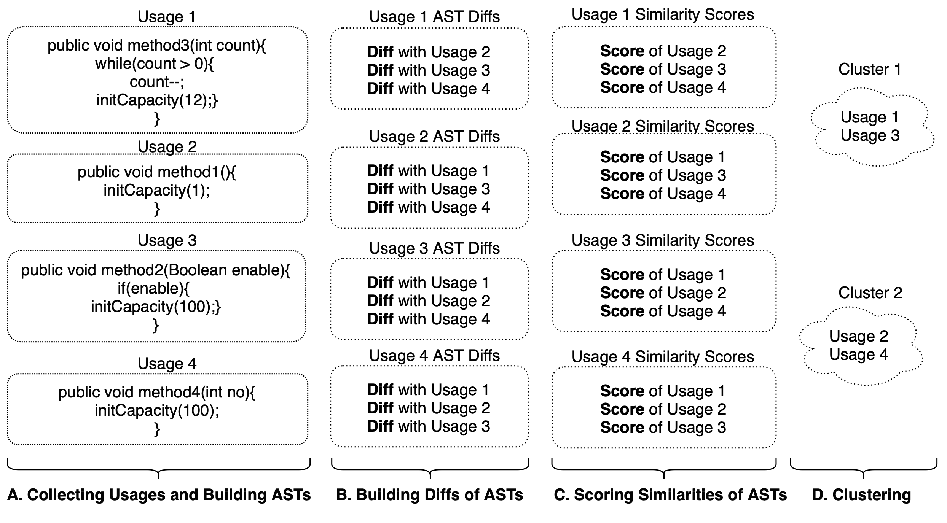
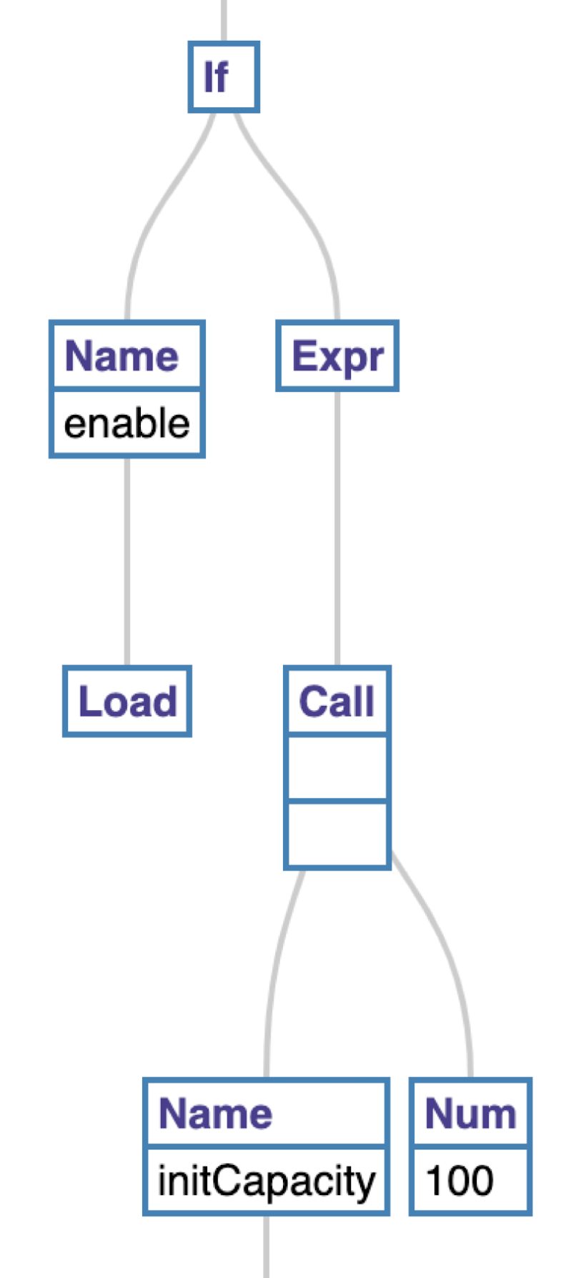
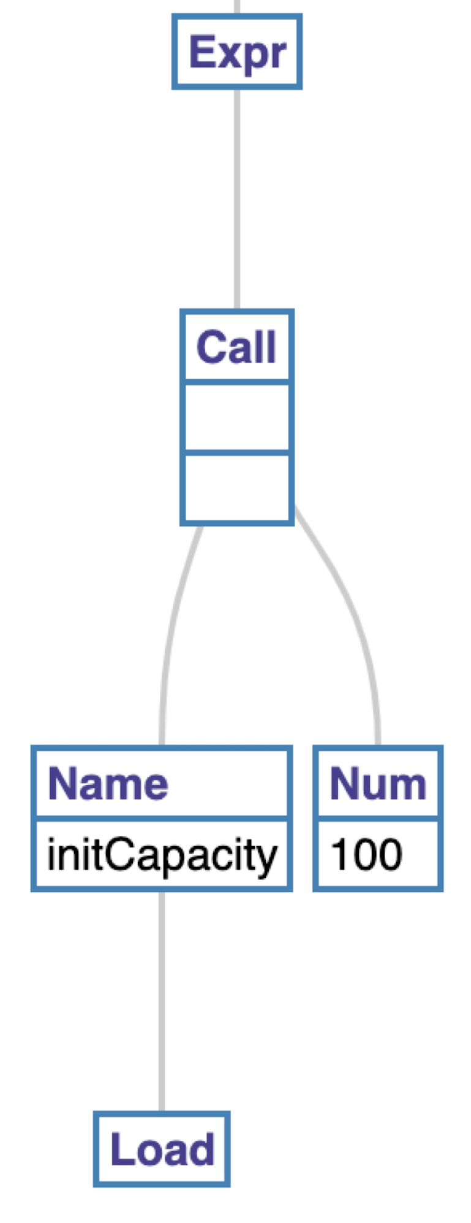
Find Unique Usages, Step A
Input: usages
Output: 4 ASTs of usages
AST Usage 3
AST Usage 4
Notes:
1.To explore this idea, we propose Find Unique Usages, which clusters usages by similarity and displays usage clusters to the developer.
2.In the first step, Find Unique Usages collects usages from the codebase. For each usage, it generates an AST. AST includes the entire body of the method containing the usage. For example

Slide 9
Find Unique Usages, Step B
Input: Asts, GumTree algo
Output: Diffs of Asts
AST Usage 3
AST Usage 4
Diff astDiffs = gumtree.AstComparator (AST3, AST4);
Set similiarities = astDiffs.getMappingsComp();
Notes:
3.Next, Using the ASTs of each usage, Find Unique Usages computes a diff of each pair of usages. Instead of string edit distance we used GumTree algo which is commonly used for code clone detection.

Slide 10
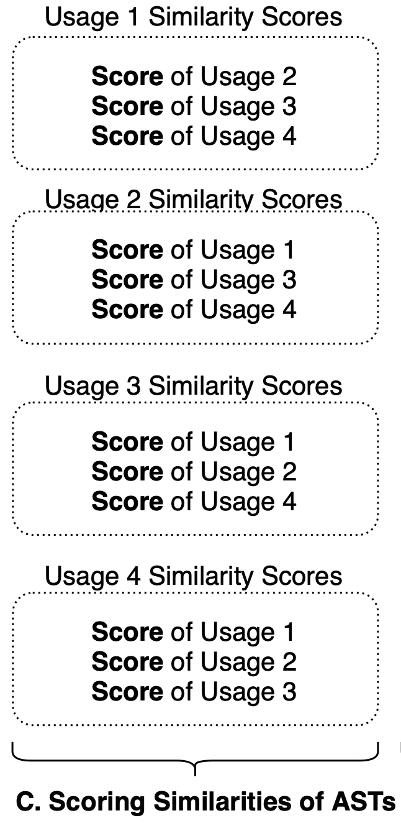
Find Unique Usages, Step C
Input: Similarity and diffs
Output: Score
Score = 2 X similar_nodes / (2 X similar_nodes + AST3_differ + AST4_differ)
Similarity scores are calculated for all pairs of usages.
Notes:
4.Instead of identify usages which constitute an exact match or count only the number of nodes which vary in the diff, we adapted an approach from prior work for computing similarity. Detail is available in paper. In the previous step GumTree give us number of shared node that we use it in this step.

Slide 11
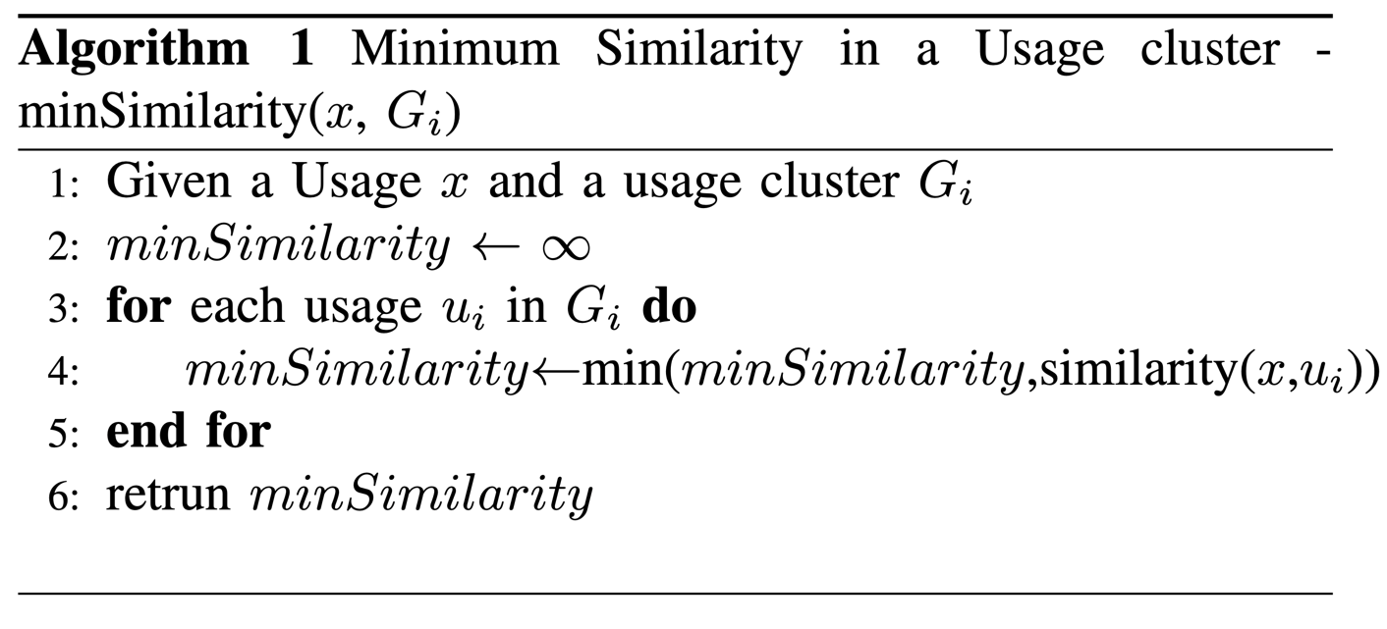
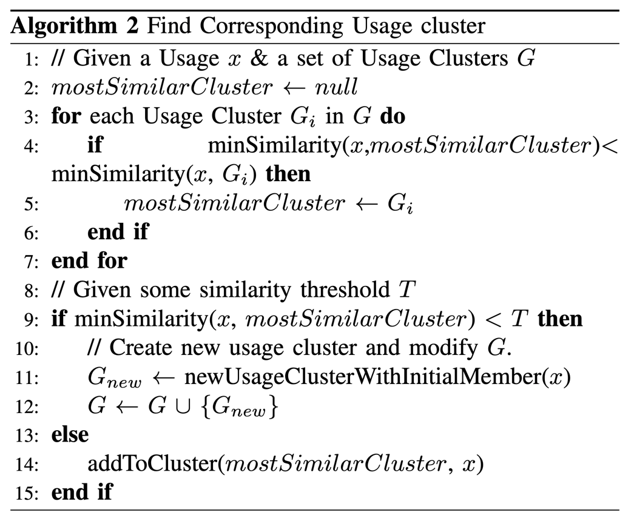
Find Unique Usages, Step D
Input: Similarity scores
Output: groups
Notes:
5.Last step is clustering. Find Unique Usages computes clusters of usages based on their similarity scores. Based on max of mins similarity, It first finds the minimum similarity between the usage and all members of all clusters separately and memoizes them. Based on max of mins similarity, it chooses the best cluster.

Slide 12
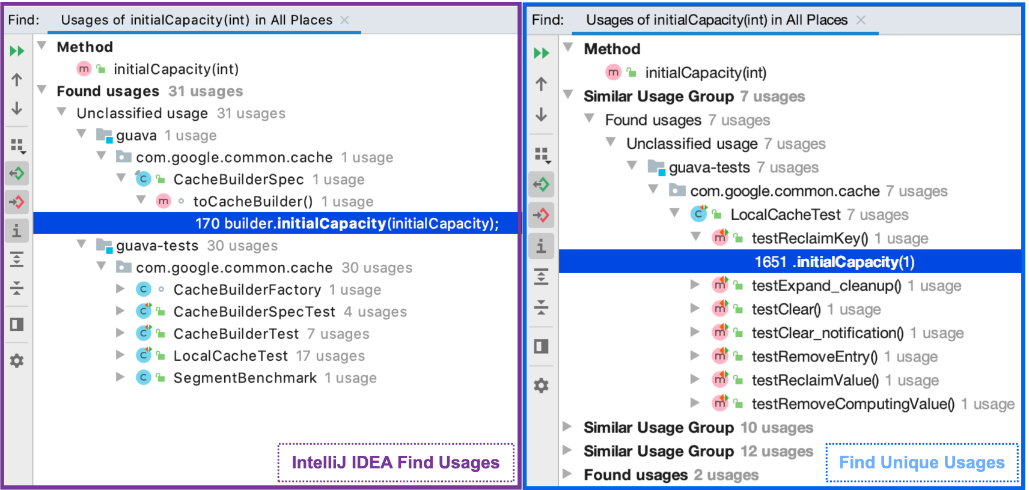
Find Usages Vs. Find Unique Usages

Slide 13





Study 2: Evaluation
Implement a feature in unfamiliar codebase
50 min
Interview
Find Unique Usages
Implement a feature in unfamiliar codebase
50 min
Interview
Notes:
To directly compare traditional programming to microtasked programming, we conducted a controlled experiment.
28 developers worked either on traditional programming tasks, described through issues, or programming microtasks.
35% of participants were student in computer science or a related field, and 65 reported working as a software engineer.
They had a median of 2.0 years experience in JavaScript.

Slide 14


Study 2: Key Results
Find Unique Usage group completed task in 21 minutes
Control group completed task in 33 minutes
Interacting with usages
Read usages sequentially. Began from the first result and proceeded further.
Did not real all usages. Selected the best usage that might help them.
Notes:
What was the important insights of the study?
We found that developers with Find Unique Usages were significantly faster. They completed their task in 35% less time.
Participants of both group had same behaviors:
They read usages sequentially from the the first usage.
None of them read all usages in list

Slide 15
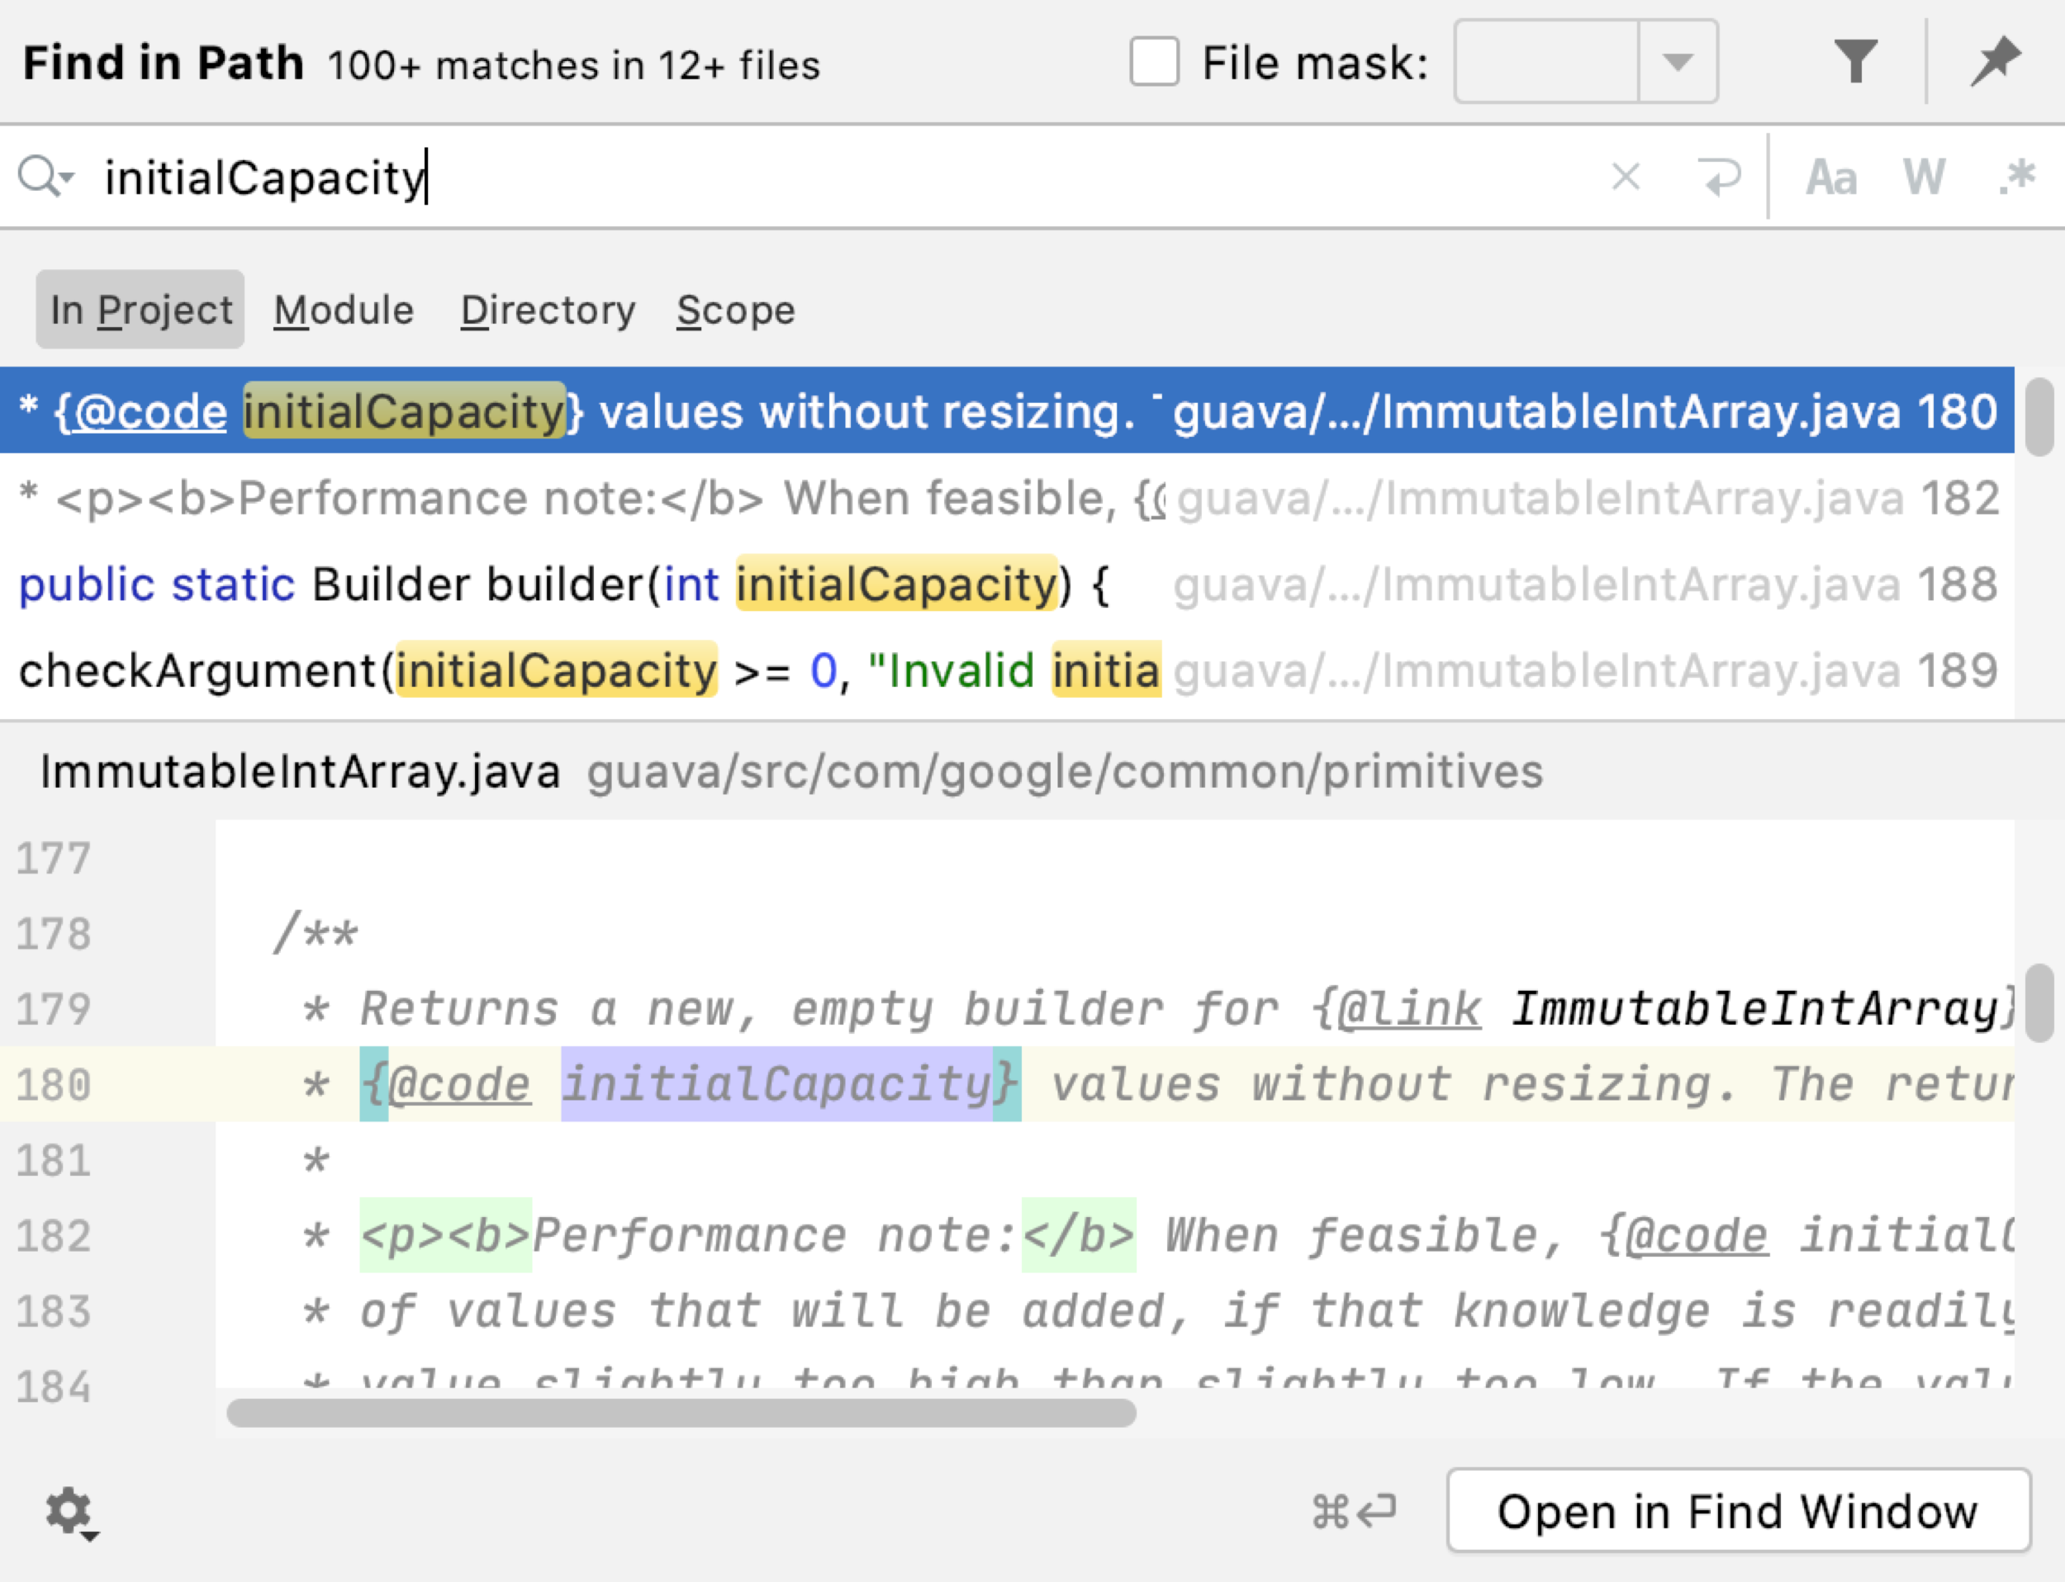
Study 2: Key Results
More successful participants
Used Find Usages with the Find In Path tools
Expanded and skimmed all usages. Selected the best usage that might help them
Challenges in making recursive use of Find Usages
Lost their place in the call graph and became disoriented
Spent time remembering where they were when re-invoking the first command they began with
Notes:
Successful participants had some patterns.
Used find usage tool with Find In Path tool to be more effective
Interesting observation was more successful developers expand all usages and skimm all of them.
Two more interesting results were:
Remembering where they start invoking Find usages after several call were hard and they got lost sometimes.

Slide 16

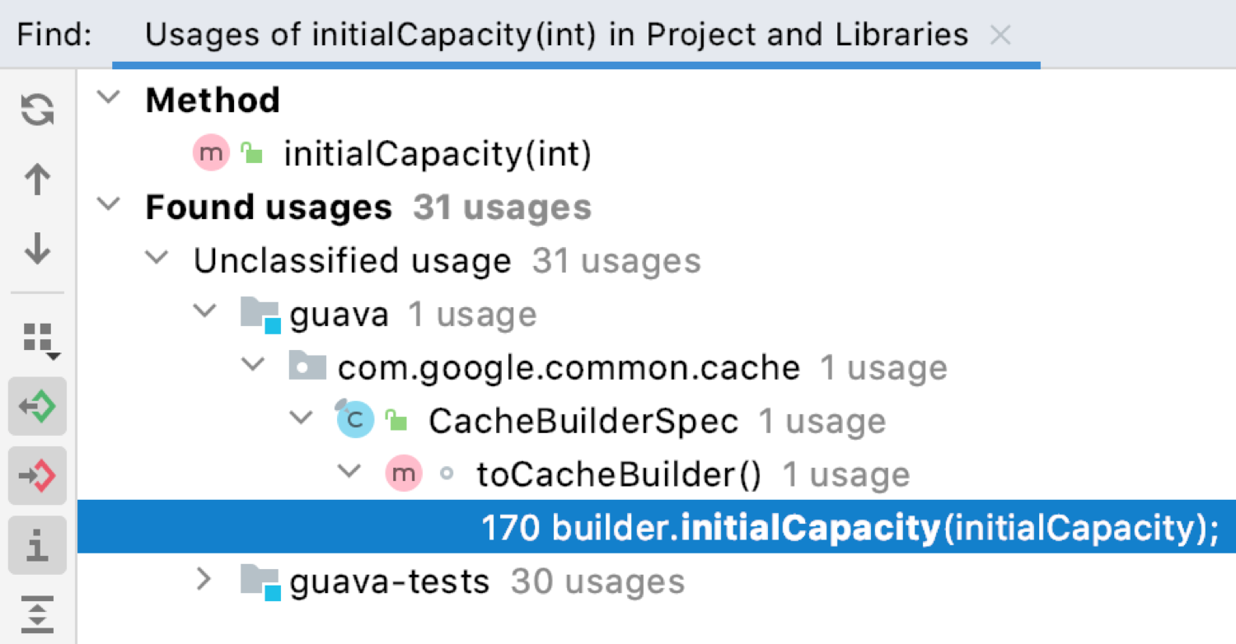
Discussion and Future Work
Offering additional evidence for the value of call graph navigation tools
How would developers' behavior change if the IDE did not highlight this first usage?
Notes:
❏Why developers choose to focus on first usages?! By default, both Find Unique Usages and Find Usages in IntelliJ expand and highlight the first usage in the list.
It is unclear how developers' behavior might change if the IDE did not highlight this first usage.
❏Our results offer additional evidence for the value of call graph navigation tools. Rather than simply looking at usages one level deep, developers often wished to understand usages by going deeper.
❏Ok. Thats is.

Slide 17

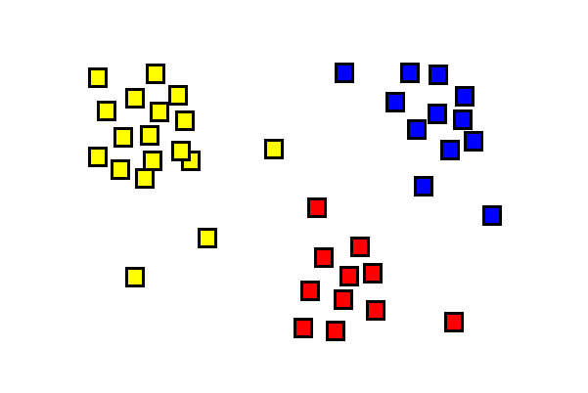
Discussion and Future Work
Systematically investigate the impact of the number of clusters chosen
There are a wide range of clustering techniques that might be used to cluster usage sites. For example, hierarchical clustering
Notes:
Also, Find Unique Usages is highly sensitive to the threshold selected. This threshold determines the number of clusters created. Future work might more systematically investigate the impact of the number of clusters chosen.
There are a wide range of clustering techniques that might be used to cluster usage sites. For example, hierarchical clustering is a common clustering approach for collecting item into groups based on similarity or distance scores. Hierarchical clustering commonly involves merging groups, which we did not implement in our approach

Slide 18

Acknowledgement
This work was supported in part by the National Science Foundation under grants CCF-1414197 and CCF-1845508.
Jon Bell
Notes:
I’d like to thank to my PhD advisors, Professors Thomas LaToza, for supporting me during these past 3 years.

Slide 19
Questions

Slide 20
Find Unique Usages Helping Developers Understand Common Usages
Emad Aghayi Aaron Massey Thomas LaToza
Department of Computer Science

Slide 21
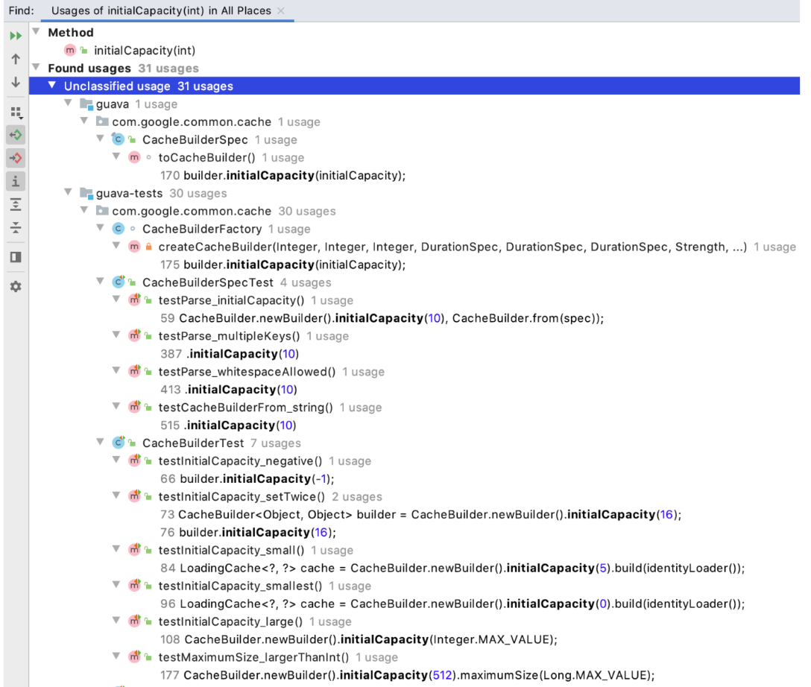
Exploratory Study, Find Usages, and its results
We found participants had difficulty parsing through the many results
Users would typically select only one or two results and focus on those
A valuable example would frequently not be the first or second result.

Slide 22
Primer on Code Clones
Ongoing field of research that is typically focused on detection of redundancy.
Makes frequent use of string, AST, or other distancing metrics to identify two pieces of code as clones or duplicates/redundant of each other.
Useful for refactoring blocks of redundant code with a single function call
Generally, code clones are bad - duplicate clones.

Slide 23
Back to Find Unique Usages
We heavily borrow from code clones work
We say that two examples have similar context if they are essentially weak code clones.
By weak code clones, we mean there is similarity, but not enough to necessarily be redundant.
We group our weak code clones as a method of grouping examples
Different groups are meant to represent different use-cases.
E.g. tests verifying a particular piece of functionality would be one group.
To us, code clones are good, or at least neutral.
More weak code clones mean more grouping of examples.
But this is tricky because we have to balance the threshold of what is in the same group.

Slide 24
Problem Statement: Learning how to use an artifact in a codebase
: Documentation
Hard to maintain it update, Might not exist, Less reliable in closed-source code
Option 2: Manually parsing code
Slow, Difficult and easy to get wrong
Option3: Learning by example
Easier than manually parsing code
Knowledge is tightly coupled with code and easier to maintain
Varied examples offer information on different use-cases
Tooling support exists, like “Find Usages”, “Open call hierarchy” and “Grep”
Notes:
How developers learn to use an artifact in a codebase? What are common approaches that developers follow?
The first Option is that developer can go through documentation and read about the artifact. But this approach has difficulties like documents are not exist or not up to date
The second option is manually reading code to understand the artifact. This approach is slow and error prone
The last one is using learning by example. This approach is easier that manually parsing code because after several examples developer will find a pattern among examples. It is better than using docomentaino because knowledge is coupled with the code.
There exist many tools to support find by examples such as Find Usages in Intellij IDEA, open Call hierarchy in Eclipse.
In this research we chose Find Usage tool of Intellij IDEA. it is one of three most popular IDEs among Java developers.

Slide 25
Why searching in codebase is important?
Understanding existing code is one of developers most time-consuming activities
Developers generally avoid relying on documentation Instead, developers tend to rely primarily on the code itself
The most frequent developer activity is code search
94% of developers search when they are working on maintenance tasks
Notes:
Developers always try to understand codebase.
One of the most time-consuming activities of developers is code understanding.
For undrestaning codebases developers have two options.
First one is documentation. But developers generally avoid relying on documentation.
Why they avoid? Perhaps one reason is that documentation is frequently out of date and poorly written and may not answer low-level questions about hidden contracts, implementation details, or side effects
Second option is understand codebase on the code itself. Developers search, they search in codebase to find examples.
Searching in code is the most frequent activity of developers. Cose search happens where developers most often look for code examples
Surprisingly, 94% of developers search when they are working on maintenance tasks.

Slide 26

Search for usage tools
Find Usages Open call hierarchy
Notes:
Ok. so far we know code search is common activity. A variety of tools assist developers in navigating and searching code.
Modern development environments offer tools for developers to Find Usages or navigate the Open Call Hierarchy.
We believe even small improvements in making this process may have an important impact.

Slide 27
Study 2: Key Results
Usages was easier to read when they contained literals directly in the call site rather than referencing variables or expressions defined elsewhere.
In both conditions, four participants struggled with method overload.
Notes:
We also found usages listed in the results window were easier to read when they contained literals directly rather than referencing variables or expressions. For example when a method accept an integer undrestanding was easier rather than when a method accept an object.
When they contains variables, developers were forced to open the class containing the usage to read and understand it.
As they had invoked another Find Usage command, they spent time remembering where they were and re-invoking the first command they began with.
All participants experienced challenges making recursive use of Find Usages.
After invoking recursive Find Usages several times, developers sometimes lost their place in the call graph and became disoriented.

Slide 28

Find Unique Usages Helping Developers Understand Common Usages
Department of Computer Science, George Mason University
Emad Aghayi Aaron Massey Thomas LaToza
Notes:
Thank you!

Slide 29
Find Unique Usages Helping Developers Understand Common Usages
Department of Computer Science, George Mason University
Emad Aghayi Aaron Massey Thomas LaToza

Slide 30

Study 2: Evaluation
12 participants (4 software engineers + 5 grad students + 3 undergrad students)
Between subjects study comparing against developers with IntelliJ Find Usages
FlyingSaucer project, approx. 99 KLOC
Semi-structured interview with participants
Notes:
❏Ok.
❏To evaluate Find Unique Usages Tool, we conducted an experiment.
❏We asked 12 developers to implement a small feature in an open-source codebase.
❏At the end of study for collecting data about experience of developers we conducted a semi-structured interview with participants.

Slide 31
Discussion and Future Work
Why developers choose to focus on first usages?! By default, both Find Unique Usages and Find Usages in IntelliJ expand and highlight the first usage in the list.
It is unclear how developers' behavior might change if the IDE did not highlight this first usage.
Using more sophisticated clustering techniques like hierarchical clustering
There are a wide range of clustering techniques that might be used to cluster usage sites. For example, hierarchical clustering
Our results offer additional evidence for the value of call graph navigation tools.
Notes:
❏Also, Find Unique Usages is highly sensitive to the threshold selected. This threshold determines the number of clusters created. Future work might more systematically investigate the impact of the number of clusters chosen.
❏There are a wide range of clustering techniques that might be used to cluster usage sites. For example, hierarchical clustering
❏Our results offer additional evidence for the value of call graph navigation tools. Rather than simply looking at usages one level deep, developers often wished to understand usages by going deeper.
❏Ok. Thats is.

Slide 32
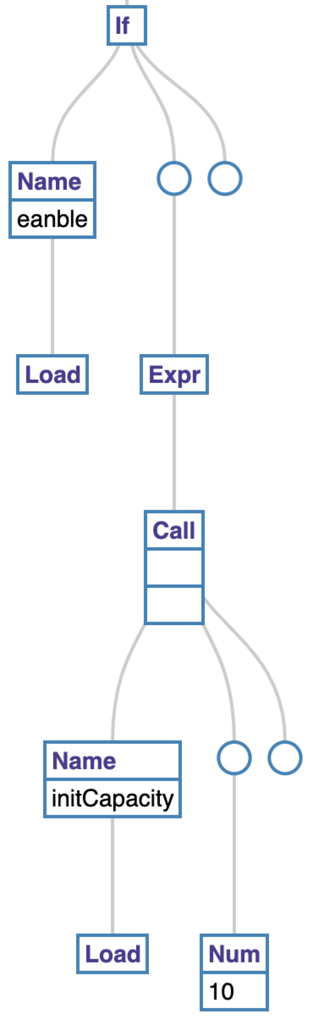

Introducing Find Unique Usages
we adapted an approach from prior work for computing similarity
Shared is the number of shared nodes between two trees calculated by GumTree, AST1 is the number of nodes which differ in usage 1 and AST2 is the number of nodes which differ in usage 2.
Similarity scores are calculated for all pairs of usages.
Example: AST created from Usage 3
Input: usages
Output: 4 ASTs of usages
Input: Asts, GumTree algo
Output: Diffs of Asts
Input: Diffs, equation
Output: scores
Input: usages, scores, max of Min algo
Output: clusters
Max of Min alog:
It first finds the minimum similarity between the usage and all members of all clusters separately and memoizes them.
It choose the max of these minimums and assign the usage to that cluster
Notes:
1.To explore this idea, we propose Find Unique Usages, which clusters usages by similarity and displays usage clusters to the developer.
2.In the first step, Find Unique Usages collects usages from the codebase. For each usage, it generates an AST. AST includes the entire body of the method containing the usage. For example in “usage 1” while loop is parent, count-- and initCapacity are sibling.
3.Next, Using the ASTs of each usage, Find Unique Usages computes a diff of each pair of usages. Instead of string edit distance we used GumTree algo which is commonly used for code clone detection.
4.Instead of identify usages which constitute an exact match or count only the number of nodes which vary in the diff, we adapted an approach from prior work for computing similarity. Detail is available in paper. In the previous step GumTree give us number of shared node that we use it in this step.
5.Last step is clustering. Find Unique Usages computes clusters of usages based on their similarity scores. Based on max of mins similarity, It first finds the minimum similarity between the usage and all members of all clusters separately and memoizes them. Based on max of mins similarity, it chooses the best cluster.

